Slide 1
Ist 782: Portfolio milestone
Kasirha Goodman

Slide 2
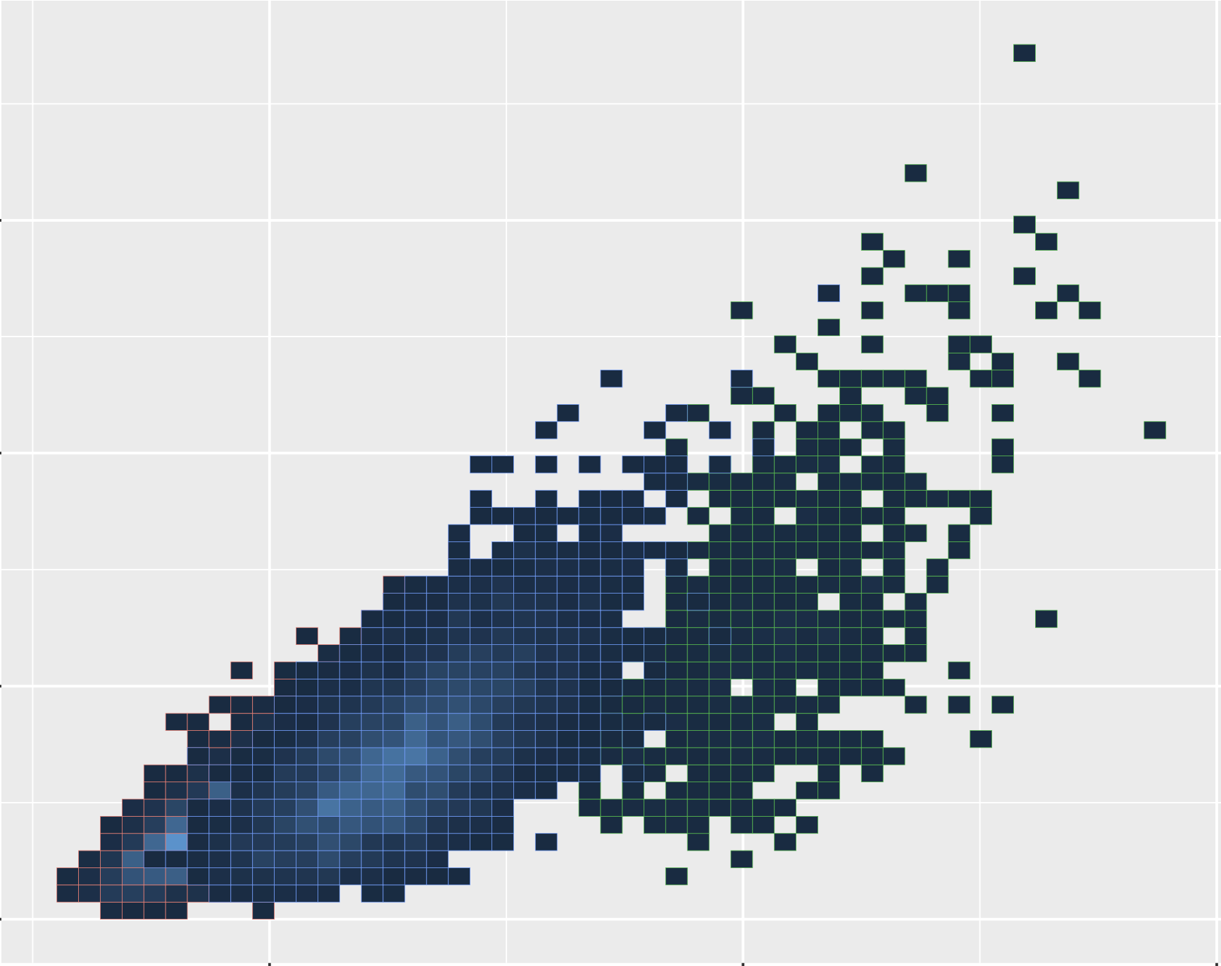
Learning Outcomes
Collect, store, and access data
Create range of actionable insights
Apply visualization and predictive models for insight
Use programming languages for insight
Communicate insights
Apply relevant data ethics

Slide 3
A Guide to the Deliverables Folder
Overview
Resume
Paper
Labelled Course Project Folders
Written Report
Raw Data
Code File

Slide 4
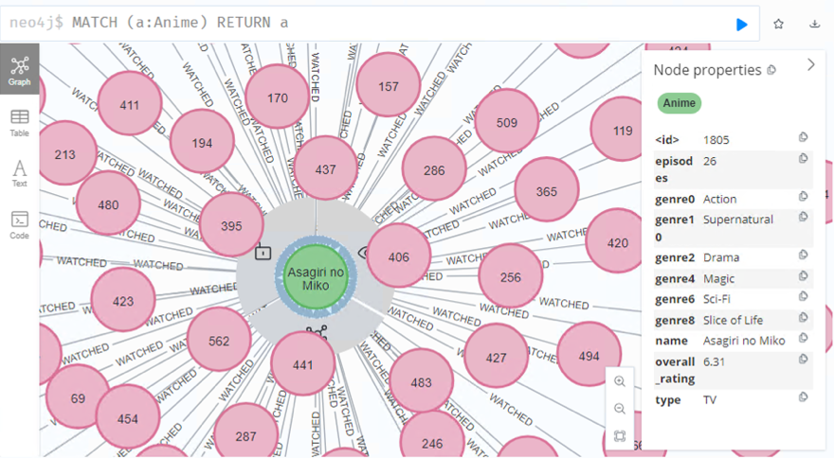
Anime Ratings and Recommendations
IST 769
Applying vizualizations
Using programming languages
Collecting, storing, and accessing data

Slide 5
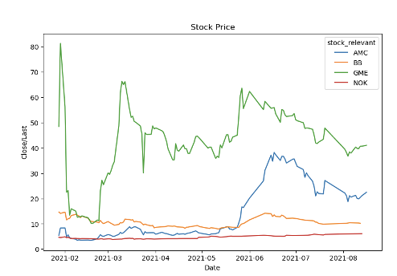
Wall Street Bets: Memes reflecting and affecting the stock market
IST 718
Applying vizualizations
Using programming languages
Creating a range of actionable insight

Slide 6
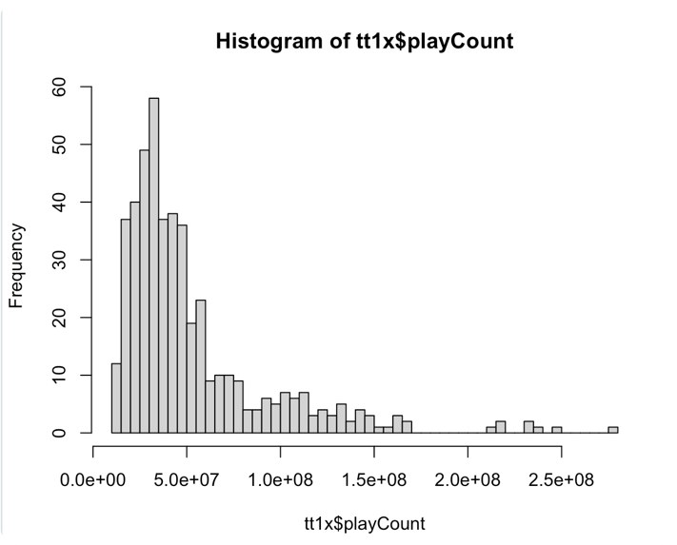
Predicting Tiktok Virality
IST 707
Applying vizualizations
Using programming languages
Applying ethics

Slide 7
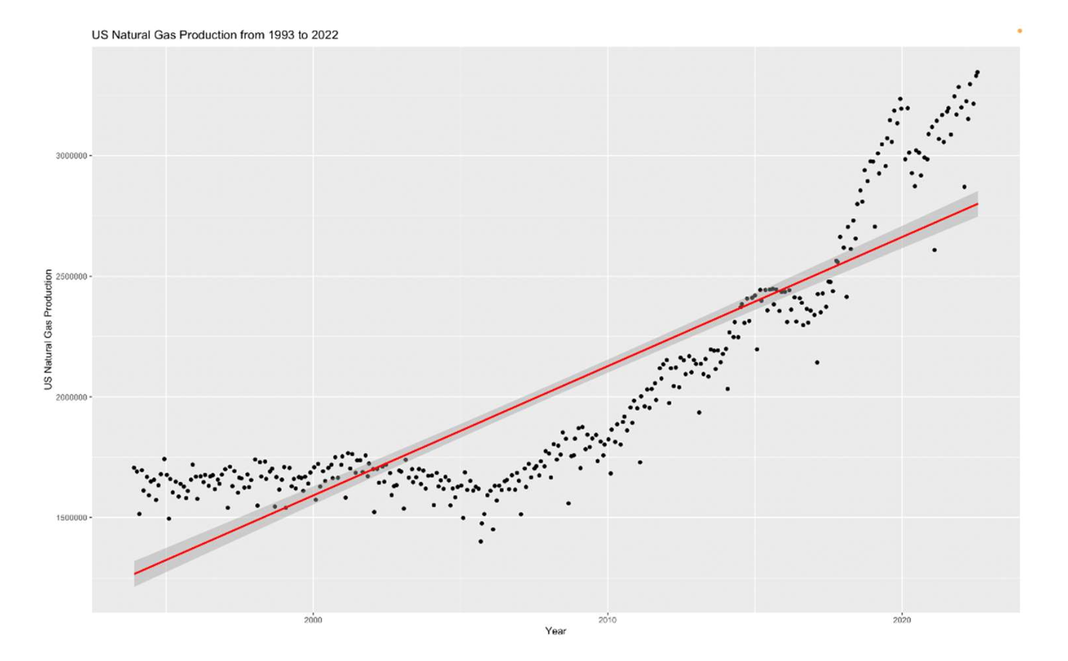
Analyzing and Predicting US Natural Gas Production
IST 687
Applying vizualizations
Using programming languages
Communicating insights

Slide 8
Conclusions
Data Pipelines and Platforms

